Slide 1
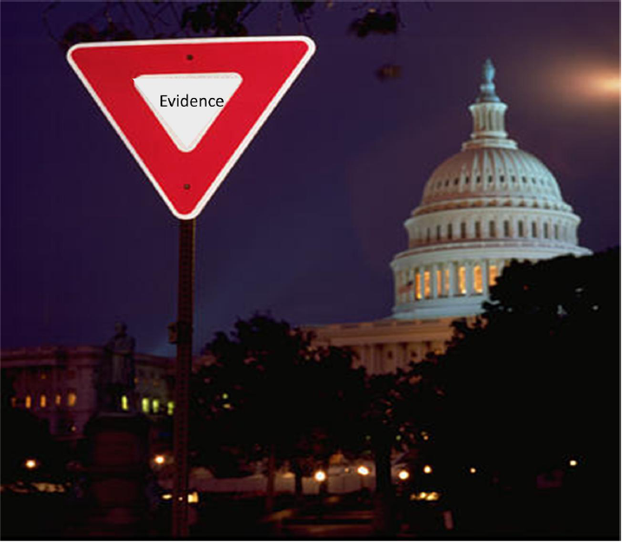
Research to Reality: The Evidence Integration Triangle
Russell E. Glasgow, Ph.D.
Deputy Director, Implementation Science
Division of Cancer Control and Population Sciences National Cancer Institute
February 12, 2011

Slide 2
Outline
Need for Implementation Research
What Do We Know About Dissemination & Implementation (D&I) Science?
How to Make Sense out of this Complexity?
The Evidence Integration Triangle (EIT)
How to Learn More- and GET FUNDED?
Future Directions and Opportunities to Get Involved
2
Notes:
PEYTON_ PLZ make header at top to reflect a word from these sections… e.g. Need; Science; The EIT; FUNDING; Opportuities- or something like that-
Please use this for template- whereever makes send=se in following- and a couple of these may need doctoring; spell check; formatting help- but have 95% of the CONTENT I want here- this needs done b COB Weds please…
THX!

Slide 3
Translation Continuum
The Need
D&I: What we know
EIT
Funding
Future Directions/D&I Opportunities
Bench
Bedside
Clinic
Community
Population & Policy
3

Slide 4
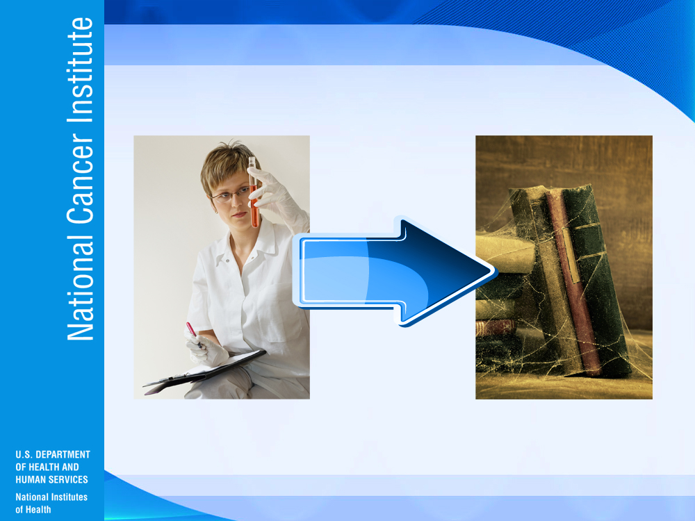
Bench to Bookshelf
4
Notes:
Really most often, T0 is used, that is bench to bookshelf. This is the problem with translation.

Slide 5
Current Situation in United States¹
The Need
D&I: What we know
EIT
Funding
Future Directions/D&I Opportunities
Underperforming health care system²
Balkanized and silo approaches
Expensive, unsustainable cost, increasing
Inequitable: Health disparities
CRISIS and OPPORTUNITY
¹Institute of Medicine. Unequal treatment…Washington D.C., National Academies Press, 2003
²McGlynn EA et al. The quality of health care…N Eng J Med 2003;348(26):2635-2645
5

Slide 6
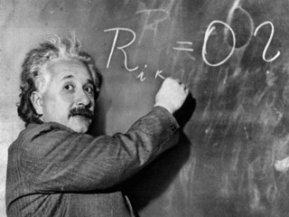
“The significant problems we face cannot be solved by the same level of thinking that created them.”
A. Einstein
6

Slide 7
Integrated Dynamic, Multilevel Research-Practice Partnerships Systems Approach
The Need
D&I: What we know
EIT
Funding
Future Directions/D&I Opportunities
Evidence-Tested Program
Health Care System
Program
as Tested
Clinic(s)
Fit
Program
Delivery
Staff
Critical
Elements
Non-critical Packaging
Delivery Site(s)
Program as Marketed
Organization
Design
Appropriate
for Question
Partnership
Research Design Team
And Adaptive Design
Broader Health Policy and
Cultural Context
Adapted from Estabrooks et. al. APJM, 2005, 31: S45
7

Slide 8
Implementation and Dissemination Research Characteristics (Russ’ view)
The Need
D&I: What we know
EIT
Funding
Future Directions/D&I Opportunities
Contextual
Complex
Multi-component programs and policies
Non-linear
Transdisciplinary
Multi-level
Glasgow R & Steiner J. (2011). In Dissemination and Implementation Research. Brownson, R, Colditz, G, and Proctor, E (Eds.). Oxford.
8

Slide 9
Rapid Learning Approaches
The Need
D&I: What we know
EIT
Funding
Future Directions/D&I Opportunities
Data Collected:
With real (and complex) patients
By real-world staff
Under real-world conditions and settings
And evaluated through real-time data (often with Electronic Health Records)
Tunis,S.R.; Carino,T.V.; Williams,R.D.; Bach,P.B. A Rapid Learning Health System. Health Affairs (supplement). 2007;26(2):140-149.
9

Slide 10
Recommended Purpose of Research (ala RE-AIM)
The Need
D&I: What we know
EIT
Funding
Future Directions/D&I Opportunities
Collect evidence to document interventions that can:
Reach large numbers of people, especially those who can most benefit
Be widely adopted by different settings
Be consistently implemented by staff members with moderate levels of training and expertise
Produce replicable and long-lasting effects (and minimal negative impacts) at reasonable cost
10

Slide 11

Ultimate Impact of an Insurance-sponsored Weight Management Program in West Virginia¹
The Need
D&I: What we know
EIT
Funding
Future Directions/D&I Opportunities
Dissemination Step | Concept | % Impacted
8.8% of Weight Management sites participated | Adoption | 8.80%
5.9% of members participated | Reach | 0.52%
91.4% program components implemented | Implementation | 0.47%
43.8% of participants showed weight loss | Effectiveness | 0.21%
21.2% individuals maintained benefit (individual) | Maintenance | 0.04%
Are they representative?
¹Abildso CG, Zizzi SJ, Reger-Nash B. Evaluating an Insurance-Sponsored Weight Management Program With the RE-AIM Model, West Virginia, 2004-2008. Preventing Chronic Disease Public Health Research, Practice, and Policy. 2010. 7(3).
11

Slide 12
The Need
D&I: What we know
EIT
Funding
Future Directions/D&I Opportunities
12

Slide 13
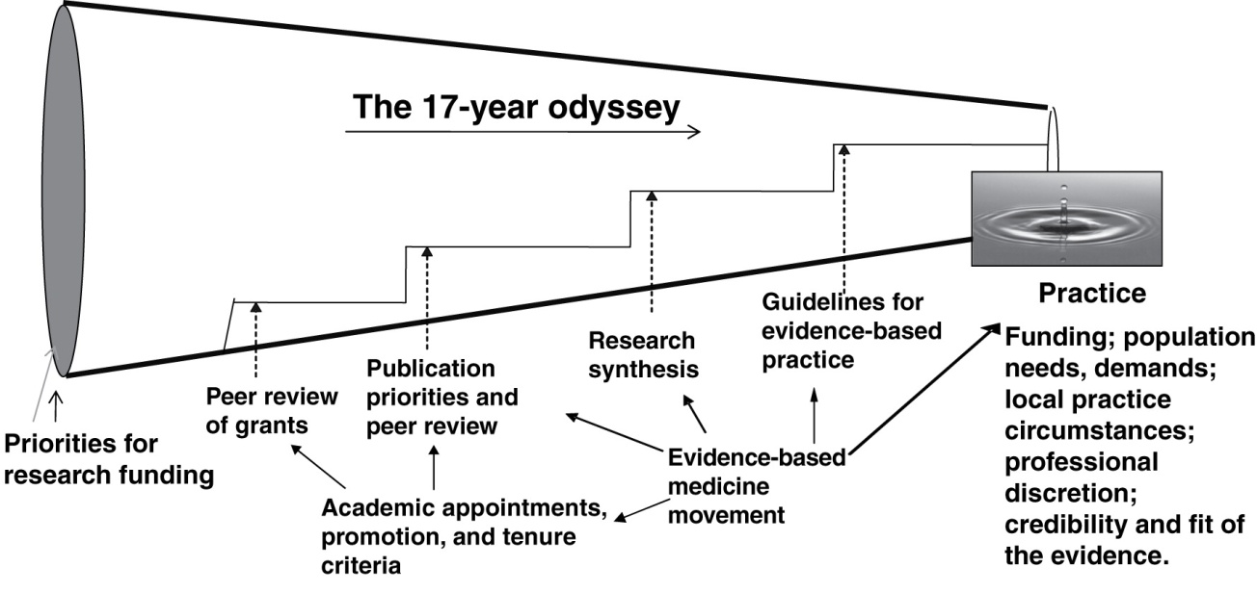
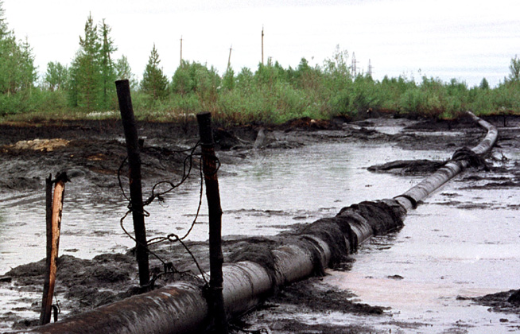
Research to Practice Pipeline
Green, LW et al. 2009. Annual Rev. Public Health. 30: 151-174
13

Slide 14
The Need
D&I: What we know
EIT
Funding
Future Directions/D&I Opportunities
Intervention Program/Policy (Prevention or Treatment)
(e.g. design; key components; principles; external validity)
Evidence
Stakeholders
Multi-Level Context
Intrapersonal/Biological | Policy
Interpersonal | Community/Economic
Organizational | Social/Environment
14
Notes:
It is all about context. And context is multi-level and all these levels need to be considered when thinking about a problem and developing or implementing an intervention.
(After first click): Next, we have to consider the stakeholders and stakeholder engagement. The stakeholders could be a community group, clinicians, political leaders, community members, program staff, etc. (provide example appropriate for audience). With this group, the goal(s) and objectives are defined and consider the evidence (be clear we mean evidence as more than just RCTs and cochrane reviews).
(After click 2): The first component of the evidence-based triangle we need to consider is the program or policy intervention. There are a number of reviews that exist (Cochrane, Community Guide, AHRQ guidelines, etc) that outline the evidence of intervention design, key components and principles. What has, in the past, been lacking is a focus on external validity. There is still work do be done so that intervention designs include factors that make research both “rigorous and relevant” and thus far we have ignored the relevance.

Slide 15
The Need
D&I: What we know
EIT
Funding
Future Directions/D&I Opportunities
Intervention Program/Policy (Prevention or Treatment)
(e.g. design; key components; principles; external validity)
Evidence
Stakeholders
Practical Measures
(e.g. actionable & longitudinal measures)
Multi-Level Context
Intrapersonal/Biological | Policy
Interpersonal | Community/Economic
Organizational | Social/Environment
15
Notes:
Leg two is the practical measures. This is how we know how well we are doing and needs to be done iteratively throughout development and implementation. But to do so, these measure must be practical so they can, like an intervention, be appropriate and relevant to the setting in which they are used.

Slide 16
The Need
D&I: What we know
EIT
Funding
Future Directions/D&I Opportunities
Intervention Program/Policy (Prevention or Treatment)
(e.g., design; key components; principles; external validity)
Evidence
Stakeholders
Implementation Process
(e.g., stakeholder engagement team-based science; CBPR; patient centered care)
Practical Measures
(e.g., practical, actionable & longitudinal measures)
Multi-Level Context
Intrapersonal/Biological | Policy
Interpersonal | Community/Economic
Organizational | Social/Environment
16
Notes:
The third leg of the triangle is the implementation process. This is really how one implements things and the evidence around the process. This has for the most part be excluded from the evidence-based focus thus far (this will be covered more in a couple of slides).

Slide 17
Intervention Program/Policy – The “What”
The Need
D&I: What we know
EIT
Funding
Future Directions/D&I Opportunities
Identify key components or theoretical principles
Need for detailed implementation guides, lessons learned manuals
Need to focus and report on both internal and external validity (need to add relevance to rigor)
Most focus on treatment; less on prevention; least on policy
“If we want more evidence-based practice,
we need more practice-based evidence.”
Green LW & Glasgow R. Eval Health Profess. 2006, 29: 126-53.
Rothwell, PM. Lancet. 2006, 365:82-93.
17
Notes:
This is the “what” - it is the theoretical principles and the key components of the intervention. Like context, these interventions are most often multi-level.
Researchers and practitioners need to provide detailed implementation guides and lessons learned – show what can and cannot be modified (key components)
Reiterate that we must focus on evidence that is both internally and externally valid (for researchers, this means developing interventions that are relevant and realistic and for practitioners, this may refer more to evaluating an intervention on both the internal and external validity before selecting and implementing it and if it is relevant for their setting). In terms of relevancy, we need to consider the cost, value, the settings, etc. in which this intervention will be ultimately delivered.

Slide 18

Practical Measures – the “So What”
The Need
D&I: What we know
EIT
Funding
Future Directions/D&I Opportunities
Measures need to be:
Brief and practical
Collected longitudinally to assess progress
Reliable and valid
Sensitive to change
Have national norms, easily understood and ACTIONABLE
Culturally appropriate across groups
Reflect multiple stakeholder perspectives
Society of Behavioral Medicine Health Policy Statement on Public Health Need for Patient Reported Measures. http://www.sbm.org/policy/patient-reported_measures.pdf
18
Notes:
More specifically, measures need to be designed and selected with evidence in mind. Measures should be… brief and practical enough to be able to be collected over time and sensitive enough to assess change (ex. Some of the best measures such as quality of life are not all that sensitive on a short term basis).

Slide 19
Implementation Process – The “How”
The Need
D&I: What we know
EIT
Funding
Future Directions/D&I Opportunities
Partnership and Community Based Participatory Research (CBPR) approaches¹
Patient-centered Care Approach
Team science in action^{2,3}
Iterative, self-correcting
¹ Guidelines and Categories for Classifying Participatory Research Projects in Health: http://lgreen.net/guidelines.html
²Gray, D. O. (2008). In C. L. S. Coryn& M. Scriven (Eds.), Reforming the evaluation of research. New Directions for Evaluation, 118, 73–87.
³Mâsse, LC, et al. Am J Prev Med. 2008; 35 (2S): S151-S160.
19
Notes:
What do we mean by this? For example, if we are talking about a primary care setting, we are talking about how patient-centered is your care. If we are talking about a community program, are you really using CBPR and partnership approaches. If we are talking about a research collaboration center, CTSI, are we really using team science principles. Or are we just paying lip service to these principles, but not actually implementing them in action.
The process needs to be iterative and self-correcting. The participants need to feel they have the permission to fail and they are not on the line. It is often through failure that we learn and correct ourselves, which, again, incorporates the need for an iterative process. And, as with the other components of the triangle, stakeholder engagement and buy-in is critical.

Slide 20
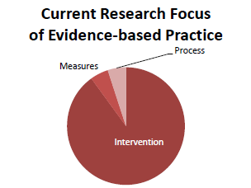
The Need
D&I: What we know
EIT
Funding
Future Directions/D&I Opportunities
CURRENT
IDEAL
Intervention Program/Policy (Prevention or Treatment)
(e.g., design; key components; principles; external validity)
Evidence
Stakeholders
Implementation Process
(e.g., stakeholder engagement; team-based science; CBPR; patient centered care)
Practical Measures
(e.g., actionable & longitudinal measures)
Multi-Level Context
Intrapersonal/Biological | Policy
Interpersonal | Community/Economic
Organizational | Social/Environment
20
Notes:
So we have our triangle with evidence-based intervention, practical measures, and implementation process. (click): what I want to talk about now is where we stand today, the status of the literature
(click): Currently, there is, in my opinion and experience, much more focus on the evidence-based interventions than on either the process or the measures among researchers and practitioners. This is what the reviews, the community guide, focuses on the intervention, the drug, the policy but there are far fewer studies and reviews that examine the evidence around the implementation process and the measures. We are just starting to see the efforts around measurement with the emergence of electronic health records for harmonized medicine at the NIH and things like PROMISE. There is very little effort put into the process.
(click): But in order to succeed, I suggest that we need to ideally balance out these three a bit more and focus our time and efforts to establishing and integrating evidence into and from each of these when designing and implementing solutions to public health problems. This is the second take home message. First is context is king, second is we need address all three of these legs of the triangle and integrate the evidence into each and integrate the legs with one another.
(Click): Like the chronic care model and most models, the key is not just that this components exist and are done, but it is how they are connected that is important. Do the activities interact with one another or do they conflict? Between the process and the intervention, here are some ways in which they may connect – Tools to assess the process of team science (which NCI is working on), for assessing CBPR (Larry Green), Patient-centered care (Kurt Stange); self-quizzes such as those on RE-AIM to make sure it is reaching the targeting audience, that it can be implemented by staff, etc.
(Click): If we look between the intervention and the practical measures,is the idea of rapid learning principles (Etheridge et al., IOM) so the measures can be repeated and used in real-world settings and can be cycled back into the design, dissemination, and implementation of interventions.
(click): Finally, the types of linkages we need between measures and process is that this needs to be transparent with stakeholders and can be used to evaluate the process and progress, which as the business field calls a learning organization.

Slide 21
The Need
D&I: What we know
EIT
Funding
Future Directions/D&I Opportunities
Intervention Program/Policy (Prevention or Treatment)
(e.g., design; key components; principles; external validity)
Feedback
Feedback
Evidence
Stakeholders
Implementation Process
(e.g., stakeholder engagement; team-based science; CBPR; patient centered care)
Practical Measures
(e.g., actionable & longitudinal measures)
Feedback
Multi-Level Context
Intrapersonal/Biological | Policy
Interpersonal | Community/Economic
Organizational | Social/Environment
21
Notes:
So we have our triangle with evidence-based intervention, practical measures, and implementation process. (click): what I want to talk about now is where we stand today, the status of the literature
(click): Currently, there is, in my opinion and experience, much more focus on the evidence-based interventions than on either the process or the measures among researchers and practitioners. This is what the reviews, the community guide, focuses on the intervention, the drug, the policy but there are far fewer studies and reviews that examine the evidence around the implementation process and the measures. We are just starting to see the efforts around measurement with the emergence of electronic health records for harmonized medicine at the NIH and things like PROMISE. There is very little effort put into the process.
(click): But in order to succeed, I suggest that we need to ideally balance out these three a bit more and focus our time and efforts to establishing and integrating evidence into and from each of these when designing and implementing solutions to public health problems. This is the second take home message. First is context is king, second is we need address all three of these legs of the triangle and integrate the evidence into each and integrate the legs with one another.
(Click): Like the chronic care model and most models, the key is not just that this components exist and are done, but it is how they are connected that is important. Do the activities interact with one another or do they conflict? Between the process and the intervention, here are some ways in which they may connect – Tools to assess the process of team science (which NCI is working on), for assessing CBPR (Larry Green), Patient-centered care (Kurt Stange); self-quizzes such as those on RE-AIM to make sure it is reaching the targeting audience, that it can be implemented by staff, etc.
(Click): If we look between the intervention and the practical measures,is the idea of rapid learning principles (Etheridge et al., IOM) so the measures can be repeated and used in real-world settings and can be cycled back into the design, dissemination, and implementation of interventions.
(click): Finally, the types of linkages we need between measures and process is that this needs to be transparent with stakeholders and can be used to evaluate the process and progress, which as the business field calls a learning organization.

Slide 22
Practical (Pragmatic) Trials: Key Contextual Characteristics
The Need
D&I: What we know
EIT
Funding
Future Directions/D&I Opportunities
Multiple, heterogeneous settings
Representative populations
Comparison conditions are real-world alternatives
Multiple outcomes important to decision and policy makers
Thorpe KE et al., Can Med Assoc J, 2009, 180: E47-57
Tunis SR et al. Practical clinical trials…JAMA 2003;290:1624-1632
Glasgow RE et al. Practical clinical trials…Med Care2005;43(6):551-557
22

Slide 23
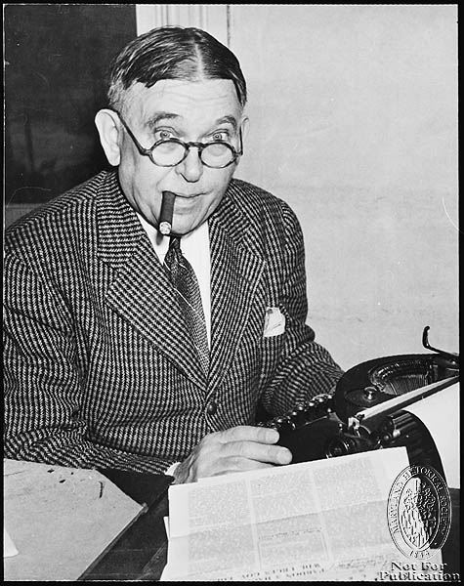
“For every complex problem there is a simple solution ... and it is wrong.”
H.L. Mencken
23

Slide 24
Bridging the Gap: A Synergistic Model Getting Evidence-based Cancer Control Interventions into Practice
The Need
D&I: What we know
EIT
Funding
Future Directions/D&I Opportunities
GOAL: To increase the adoption, reach and impact of evidence-based cancer control
Science Push
Documenting, improving, and communicating the intervention for wide population use
Delivery Capacity
Building the capacity of relevant systems to deliver the intervention
Market Pull/Demand
Building a market and demand for the intervention
Increase the number of systems providing evidence-based cancer control
Increase the number of practitioners providing evidence-based cancer control
Increase the number of individuals receiving evidence-based cancer control
ULTIMATE GOAL:
Improve population health and well-being
Tracy Orleans ( RWJF) – Designing for Dissemination Conference Presentation, 9/02
24
Notes:
24

Slide 25
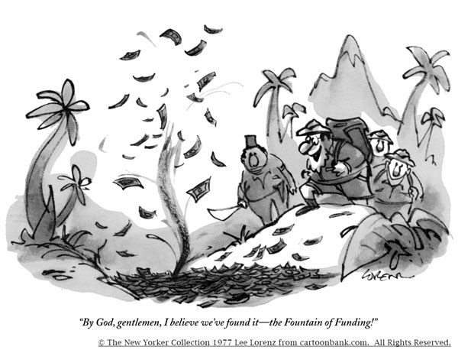
25

Slide 26

The Major Cross-NIH D&I Funding Announcement
The Need
D&I: What we know
EIT
Funding
Future Directions/D&I Opportunities
R01 - PAR 10-038 ($500k per annum up to five years) R03 - PAR 10-039 ($50K per annum up to two years) R21 - PAR 10-040 ($275K up to two years)
Participating Institutes: NIMH, NCI, NIDA, NIAAA, NIAID*, NHLBI, NINR, NIDDK*, NINDS*, NIDCD, NIDCR, & Office of Behavioral & Social Sciences Research
Starting October 2010, new standing review committee, Dissemination and Implementation Health Research
Three submission dates per year: February, June, October
* New Participating Institutes
26

Slide 27
Key Features
The Need
D&I: What we know
EIT
Funding
Future Directions/D&I Opportunities
“To identify, … and refine effective and efficient methods….
…….. and strategies to disseminate and implement research-tested …
…. interventions and …. prevention… and Quality of Life improvement services…….
in public health and clinical practice settings”
http://dccps.cancer.gov/d4d/research_portfolio.html
27

Slide 28
Other D &I Mechanisms
The Need
D&I: What we know
EIT
Funding
Future Directions/D&I Opportunities
CTSA funding at many medical schools
Partnerships with Prevention Research Centers
Some CDC Mechanisms
AHRQ Funding- especially via PBRNs and EHR Related
Other NIH and private funding (ACS, etc.)
28

Slide 29
Key Content Issues Funded
The Need
D&I: What we know
EIT
Funding
Future Directions/D&I Opportunities
Implementation of evidence-based interventions in healthcare and community settings
Workplace health promotion
Survey of state (provincial) tobacco plans and implementation research to reach and assist underserved populations
29

Slide 30
Key Questions Asked By Reviewers
The Need
D&I: What we know
EIT
Funding
Future Directions/D&I Opportunities
Is this program or policy ready for dissemination?
Is team really transdisciplinary?
Will this advance the field; how is it innovative?
Is there a good plan for sustainability or broader dissemination of the project?
30

Slide 31
Content Issues Seldom Addressed (Research Opportunities)
The Need
D&I: What we know
EIT
Funding
Future Directions/D&I Opportunities
Comparative Effectiveness Research
Dissemination to large number of settings
Proposals addressing complex patients, complex and multilevel problems
Health policy issues
Dissemination & implementation of systematic review evidence
31

Slide 32
Annual D&I Meetings
The Need
D&I: What we know
EIT
Funding
Future Directions/D&I Opportunities
“State of the D&I Science” Venue
Three meetings held since 2007
Participation increased from 350 registrants in 2007 to over 900 in 2010
Past themes have included: “Building Capacity” and “Methods and Measures”
Next meeting: Bethesda, MD March 21-22, 2011 Theme: Policy and International Contributions
Registration: http://conferences.thehillgroup.com/obssr/DI2011/index.html
32

Slide 33
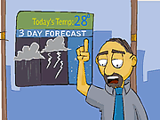
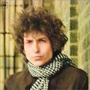
PREDICTING THE FUTURE…
“You Don’t Need a Weatherman
To Know Which Way the Wind Blows”
-Bob Dylan
33

Slide 34
Evolving Issues
The Need
D&I: What we know
EIT
Funding
Future Directions/D&I Opportunities
Simulations, MODELING, system dynamic models
Time-lagged REPLICATIONS
Natural experiments
Well-documented quality improvement studies
RAPID LEARNING and electronic medical records (EHR) databases¹
Practical and pragmatic trials²
¹Etheredge LM, Health Affairs, 2007, Web Exclusive Collection: w107-118
²Thorpe KE et al., Can Med Assoc J, 2009, 180: E47-57
34
Notes:
Under simulations, modeling: prior to large-scale efforts, identify unanticipated outcomes

Slide 35
Challenges and Conclusions
The Need
D&I: What we know
EIT
Funding
Future Directions/D&I Opportunities
The future is multiple (conditions, behaviors, interactive modalities)
The future is complex (and we ignore complexity at our peril)¹
“All models (and designs) are wrong” ²– and greater tolerance, respect, and creativity is needed
We need to UN-learn much of what we have been taught to answer the tough questions
¹Glasgow RE, Emmons KM. Annual Review of Public Health Dec 6,2006 epub ahead of print
²StermanJD. Syst Dynam Rev 2002;18:501-531
35

Slide 36
Evidence that…
The Need
D&I: What we know
EIT
Funding
Future Directions/D&I Opportunities
IS MORE | IS LESS
Contextual | Isolated
Practical, efficient | Abstract, intensive
Robust, generalizable | Singular (setting, staff, population)
Comparative | Academic
Comprehensive | Single outcome
Representative | From ideal settings
36

Slide 37

37

Slide 38
COMMENTS, QUESTIONS, ETC.
Russell E. Glasgow
Email: glasgowre@mail.nih.gov (preferred)
Phone: 303-435-4912
NCI Implementation Science Website: http://cancercontrol.cancer.gov/d4d/
38

Slide 40
Evidence Integration Triangle
Translation Across the Continuum
Intervention Program/Policy (Prevention or Treatment)
(e.g., design; key components; principles; external validity)
Feedback
Feedback
Evidence
Stakeholders
Implementation Process
(e.g., stakeholder engagement; team-based science; CBPR; patient centered care)
Practical Measures
(e.g., actionable & longitudinal measures)
Feedback
Multi-Level Context
Intrapersonal/Biological | Policy
Interpersonal | Community/Economic
Organizational | Social/Environment
40

Slide 41
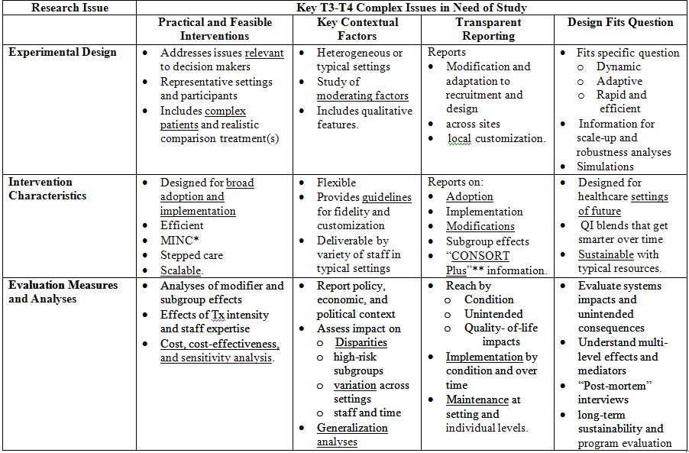
Key Pragmatic and Translation Content Issues in Need of Study by Research Design, Intervention and Evaluation Issues
The Need
D&I: What we know
EIT
Funding
Future Directions/D&I Opportunities
41

Slide 42
WHY? (Targets for Change?)
The Need
D&I: What we know
EIT
Funding
Future Directions/D&I Opportunities
Much research not relevant to patients, practitioners, policy makers
Vested interests (FDA model)
Way we were trained – “unlearning”
Complex, “wicked issues”¹
Insufficient funding (98.5% NIH budget for basic)
¹Kreuter MW et al. Understanding wicked problems. Health EducBehav2004;Aug;31(4):441-454
42

